Slide 1


Safer Illinois and RokWall: Privacy Preserving University Health Apps for COVID-19
Vikram Sharma Mailthody, James Wei, Nicholas Chen, Mohammad Behnia, Ruihao Yao, Qihao Wang, Vedant Agrawal, Churan He, Lijian Wang, Leihao Chen, Amit Agarwal, Edward Richter, Wen-Mei Hwu, Christopher W. Fletcher, Jinjun Xiong, Andrew Miller, Sanjay Patel
Notes:
Hello everyone, I am … today I will be speaking about our work ”….”

Slide 2
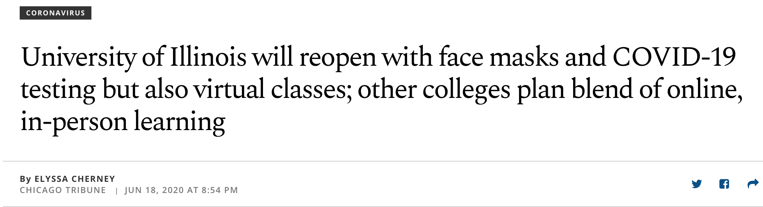
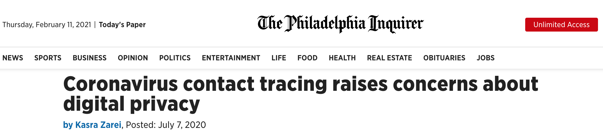
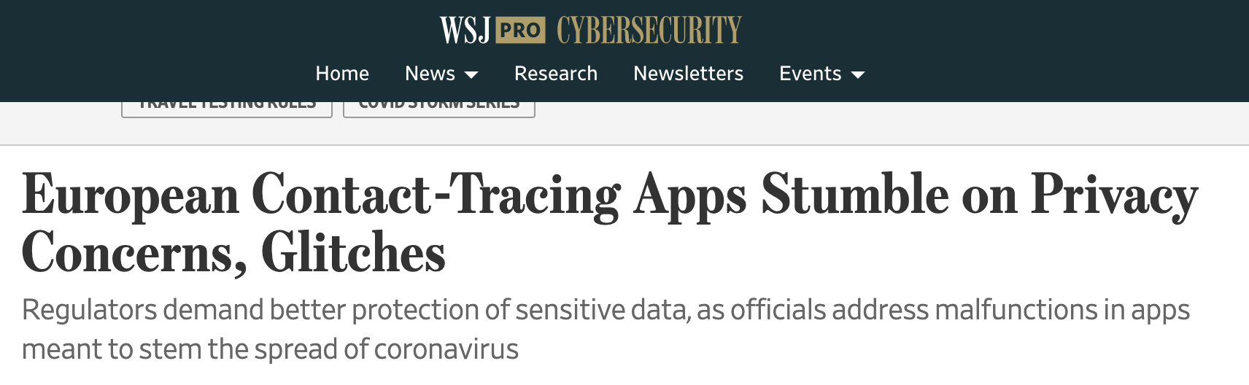
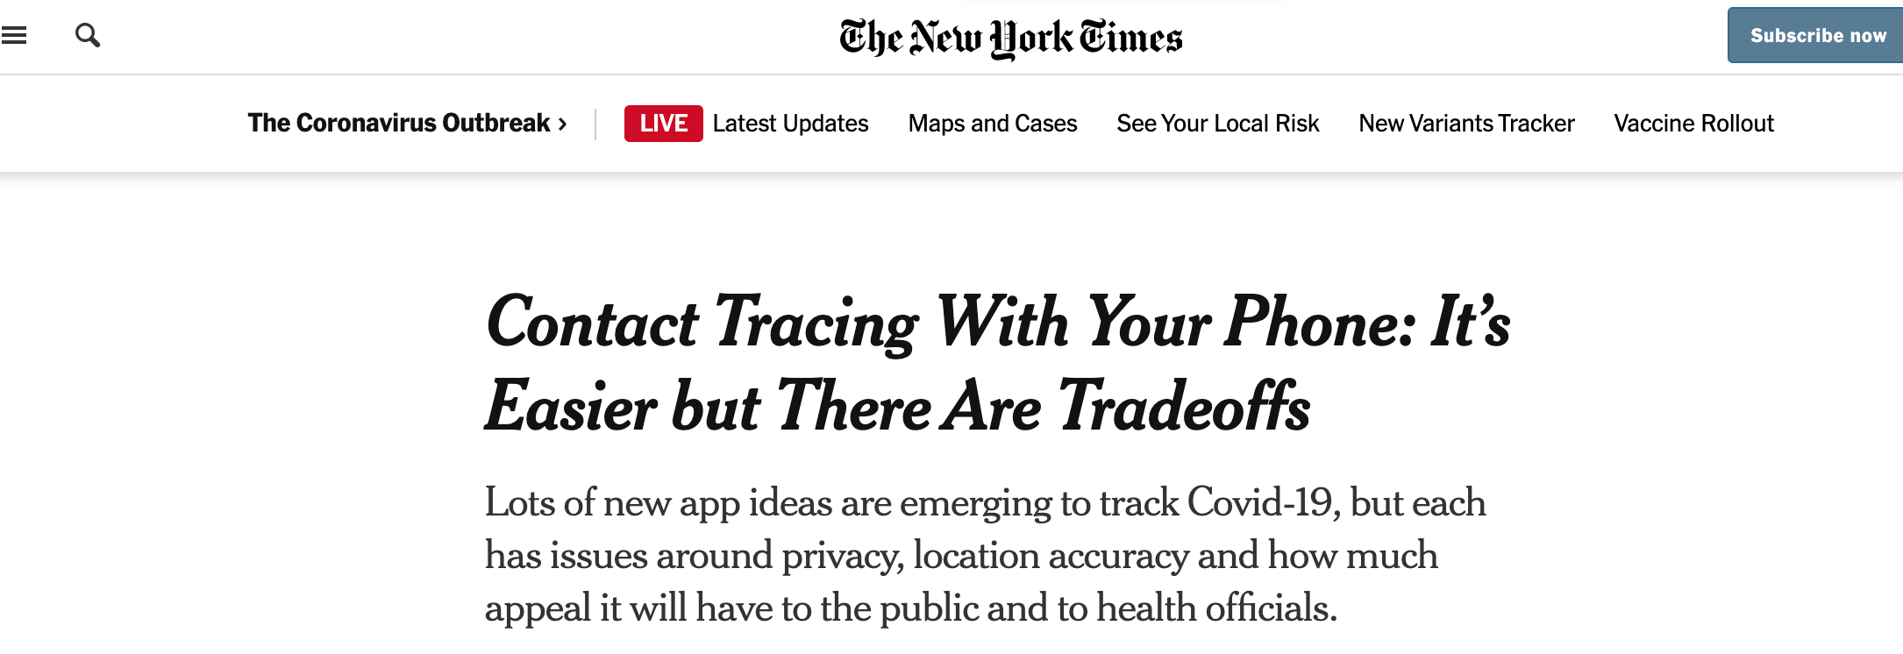
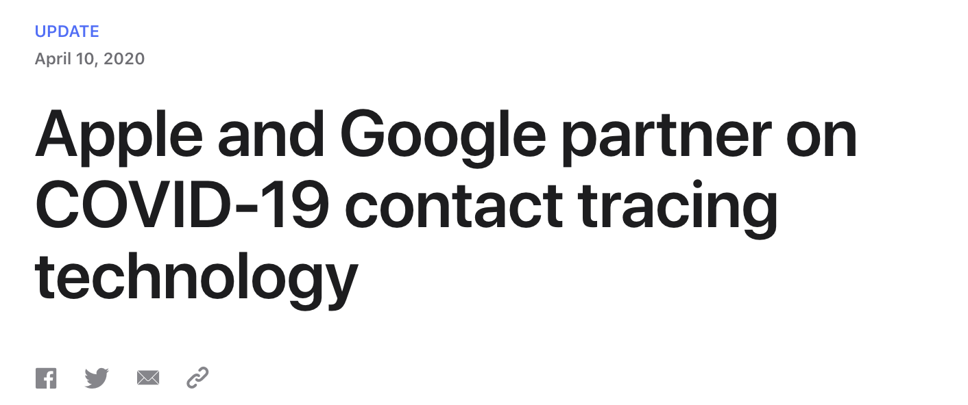
Notes:
Since early 2020, exposure notification technologies have become integral components of public health strategies worldwide, some employing GPS based analysis and others relying on Bluetooth communication.
As we know, COVID-19 mainly spreads by close interpersonal contact so contact tracing is believed to be effective in forecasting infection events.
However, an ongoing discussion remains on how to best collect and analyze sensitive data while upholding user privacy.
In the summer of 2020, the UofI declared it would reopen campus for hybrid online/in-person instruction with an emphasis on frequent testing and face mask adoption.
Campus authorities assigned our team to build tech solutions to track and mitigate the spread of COVID-19 and facilitate a safe reopening of the campus community

Slide 3
Motivation (Requirements)
Need data analytics on sensitive data
Trusting service providers is hard.
Need security:
Resilient to attackers, cloud service providers, and manufacturers
Even if security breach occurs, resulting data should be useless
Need privacy guarantees:
My data is used only by the services I authorize
3rd party cannot access data beyond its intended functionality
Data is not exploited for sales or advertisement
University Apps can create legitimate trust as credible, non-profit organizations
Notes:
Ultimately, our goal was to develop systems capable of useful analytics on sensitive data in a secure, privacy-preserving manner. The analysis can be as simple as health status checks to regulate building access or as complex as retroactively identifying super spreader events to guide public policy decisions.
Concretely, we want to guarantee that sensitive data, such as COVID-19 test results, are resilient to both attackers and malicious service providers, and even if a data breach occurs, the leaked data is useless.
Additionally, we want to prevent 3rd party services from exploiting the private data beyond its specific functionality or monetizing the data.
To this end, we believe that universities can play a crucial role in this area as they are viewed as relatively trustworthy organizations suitable for establishing public auditors and review processes.

Slide 4
Outline
Safer Illinois – decentralized exposure notification system
Launched Aug 2020 at UIUC
Variants of app – SaferBadger (UWisc), Safer Community (CUHD) …
Design and security
Implementation challenges
Safer Illinois early statistics
RokWall – centralized secure-privacy preserving computing infra.
Motivation
Design and security
Implementation challenges
Notes:
Subject to these principles, our team has developed two secure, privacy preserving computing infrastructures to combat the COVID-19 pandemic.
First, we present Safer Illinois, a decentralized exp notification system developed with privacy as primary goal based on the GAEN protocol
Second, RokWall, a centralized system to perform complex analytics which Safer Illinois cannot
Safer Illinois has been deployed at UIUC since Aug 2020 and several other universities beginning in spring 2021 while RokWall is still under active development.
We will analyze each of these systems in turn, discussing design considerations, challenges, and lessons learned.

Slide 5
Safer Illinois
Decentralized exposure notification system using Google/Apple APIs.
Notes:
First Safer Illinois

Slide 6
Safer Illinois
Assumes frequent testing of users
Privacy-first philosophy
Decentralized architecture
Open-source codebase
Minimal data policy
Services:
Exposure notification based on GAEN (voluntarily)
Health status card
Receive test results and find testing locations
Notes:
Safer Illinois leverages and supports frequent community-wide COVID-19 testing, essentially holding a digital version of your health status.
As security-conscious consumers ourselves, we adopted a privacy-centric philosophy from the onset.
We chose decentralized, privacy-preserving protocols when available so that data can remain on the user device for its entire lifespan.
Our code is open source and the app collects minimal data to fulfill its functionality.
Safer Illinois provides 3 main services:
a) exposure notification based on the GAEN Protocol
b) health status card and
c) Storing test results and locating testing centers
Now lets look at how Safer Illinois works…

Slide 7
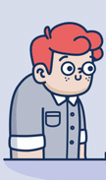
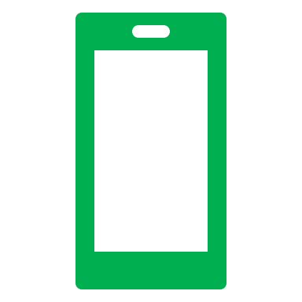
Safer Illinois Operation
Sign up
Mobile Device
1. User signs up with credential in Safer Illinois App
2. User undergoes test at testing site
3. Testing center uploads the test result data to server and user’s phone retrieves it. (unique encryption key)
4. User displays health status on their phone to gain building access
5. App constantly emits and captures Bluetooth RPIs to perform exposure notification
Test
Testing Center
Test Result
Access
Building
Sensitive data storage and computation occurs entirely on user owned device
Bluetooth
Notes:
The user first signs up for the App and a encryption key pair is generated.
When the user undergoes testing, the testing site takes their public key and encrypts the test result which is later uploaded to the Testing center server.
When the result becomes available, it pulls and stores it in encrypted format.
Now, the phone holds a digital version of its owners COVID-19 test status.
If the user attempts to access a building, they can simply display their Safer Illinois status card to verify a negative test.
If contact tracing is enabled, Safer Illinois periodically emits and captures RPIs. If a user later tests positive, they can voluntarily publish past identifiers to send exposure notifications to devices who came in close contact
Note that in this entire process, the sensitive data storage and computation occurs entirely on the user device.

Slide 8
Security analysis
Attacks addressed:
Service provider attempts to access plaintext user data
Data stored only on user device in encrypted format
Service provider uploads malicious code to App Store
Code is open source for public auditors to review
User shows false status card with modified app
Status card generation requires secure authentication with server
Resource exhaustion attack
Limit RPI storage and random evict
Network adversary
End-to-end TLS
Notes:
Now, let us discuss several interesting security implications of Safer Illinois
First, we guarantee that a service provider cannot directly access sensitive user data by storing medical information in encrypted format only on the user’s phone
If a service provider attempted to upload malicious code to the app store, public auditors could detect this by reviewing the open source code base
A malicious user may try to circumvent COVID restrictions on accessing University building by modifying their app’s source code, but we prevent this by requiring secure authentication before generating status cards
To prevent resource exhaustion attacks, we limit RPI storage on the device and randomly evict data
We address network-adversaries by using end-to-end TLS communication

Slide 9
Security analysis
Remaining challenges:
Bluetooth MAC + RPI alignment
Android can restart advertising service to forcibly refresh MAC
iOS remains unsolved
Can we solved with GAEN entitlement (we don’t have it)
2. iOS Background Execution
Suspended apps cannot generate or record RPI tokens
Currently, we do not let the app to go to background!
Notes:
However, we acknowledge several remaining limitations including ones mentioned by Serge in his keynote and we are constantly fixing them.
As discussed in the previous talk, we agree that Bluetooth Mac+RPI alignment is a problem not fully addressed. However, at least in the case of android, we can forcibly refresh the MAC address by restarting advertisement. Unfortunately, this cannot be done in iOS.
iOS also has additional limitations. For example, suspended apps cannot generate or record RPI tokens and thus we have to make sure Safer Illinois never goes to sleep. This introduces a trade off with battery life.
While GAEN solves this issue by utilizing elevated app privileges, we have not received entitlements to the official backend and had to develop our own, independent version.

Slide 10
Safer Illinois Statistics
82.5 % of the total university population have used Safer Illinois at least once in Fall 2020
From 11/30/2020 to 12/15/2020, we recorded 53% of those users voluntarily enabling exposure notification
Strict underestimate – we check for exposure notification usage only when the user takes COVID-19 test.
Not all users keep the exposure notification on all the time
Battery consumption issue.
Notes:
Now we present some early statistics on how the app is used on campus.
Speak the slide.

Slide 11
Safer Illinois Summary
We have a scalable, privacy-preserving system that is production ready!
Deployed in UIUC and variants in many other communities (CUHD community, UWisconsin, many more).
Decentralized exposure notification system and health status cards assume each user has access to mobile device
Limited analysis
In practice:
Not everyone has access to a mobile device (<K-12, damaged or forgotten)
Compatibility issues
Mobile upgrades – Stored RPIs requires to be transferred securely
Need for centralized analytics – COVID heat map, super-spreader events
Notes:
In summary, we have discussed how safer Illinois enables exposure notification and heath status cards while upholding user privacy by leveraging a decentralized architecture. It is already deployed at large scale and helping communities across the country.
However, there are several fundamental limitations to this system in practice. First, it assumes that all users have access to mobile device. In reality, not everyone has access to mobile device.
Moreover, there is need for centralized analytics to guide public policy formation. For example, detecting super-spreader events.
While Safer Illinois’ decentralized architecture is sufficient for individualized applications, it is unable to securely support desirable aggregated computations, such as COVID-19 heatmaps or super spreader event detection.
To that end, we propose RokWall … (next slide)

Slide 12
RokWall
Secure privacy-preserving centralized computing using Trusted Execution Environments
Notes:
A system for secure, privacy-preserving centralized computing built on Trusted Execution Environments

Slide 13

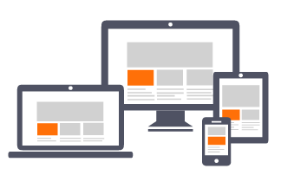


RokWall Strawman Design
Open Sourced and Audited
User Data
Building Block Functions
3rd Party Service
Encrypted DB
Building Block Functions
3rd Party Service
Compute Inside Enclave
3rd Party Service
User Device
RokWall
I
Notes:
RokWall performs user authorized computation on encrypted data within an enclave. A strawman design of the RokWall architecture is shown here. Each BB represents a specific computation, like heat map creation or risk score calculation, and are open-sourced and audited. Any 3rd party service can perform computation on the user data if the user has provided permission. Unauthorized 3rd parties will be strictly denied access to the data.

Slide 14
RokWall Key Features
Built on Enclaves
Protected hardware/software computing environment supporting a data sealing operation (Intel SGX or AWS Nitro enclaves)
Available in the cloud at affordable pricing
Data sealing
No plain-text medical data is stored​
Data is can only be used within its predefined, verifiable enclave
Remote attestation
Method by which a client system authenticates an enclave’s hardware and software configuration on a remote server.
Guarantees that computation and encryption are exactly as described
Enables public auditing services
Authorities can verify the program by remote attestation
Reproducible and planned to be open-source once developed
Notes:
Traditionally, centralized computing requires the service provider to be able to access user data in plaintext format. However, RokWall leverages secure enclaves to provide privacy and accountability, even within a centralized framework. RokWall can work on either hardware based enclaves like Intel SGX or on software based enclaves like AWS Nitro depending on the privacy requirements application dictates. One of the concerns that we often hear is the limited access to the such enclaves. However in the last one year, we have seen enclaves being readily available in the cloud for affordable pricing. In addition to this, RokWall provides data sealing capabilities.
Speak the slide.

Slide 15
Virtual Health Status Card with RokWall
User signs up and sends encrypted key pair to enclave
User takes test at testing site
3. Testing center uploads encrypted medical data to enclave
4. User attempts to gain access to protected building
5. Building Admin queries enclave through webapp
6. Enclave performs secure computation, returns status result to the webapp
pk_{user}
Test Site
Enc(test_data, pk_{enc})
Data updates
Data updates,
Queries
Enc(sk_{user}, pk_{enc.})
Service provider
RokWall Enclave
Status
Query
Status
Result: Centralized service provider now serves an intermediate role; storage and computation occurs entirely within secure enclave environment!
Building
pk_{user}
webapp
Notes:
As a concrete example of the RokWall architecture, consider our previous usecase: centralized COVID-19 status cards. While the Safer Illinois implementation ensures user privacy by storing all data on the user’s device, we can achieve similar privacy guarantees with RokWall while absolving the need for user-owned smartphones. Now, the test site seals user data and sends it to the centralized, but trustworthy, enclave. Later, a health representative in the building can request an anonymous user’s COVID-19 status by querying the enclave. Note that the service provider functions only as an intermediary who transmits securely encrypted data.
Critically, no party can decrypt the sealed user data except for the enclave.

Slide 16
Strong Privacy Guarantees using RokWall
Previously: Decentralized framework requires personal devices and limits analysis
RokWall enables trustworthy, accountable centralized computation
Previously: Centralized service provider may access plaintext, individual medical data
Addressed by data sealing and remote attestation
Previously: Clients may attempt fraudulent queries to uncover user information
Addressed by credible alert systems and rate limits using remote attestation
Notes:
More generally, RokWall provides a framework for secure, privacy-preserving centralized computation using enclaves, enabling richer, population-scale analytics to inform policy decisions and reducing reliance on user-owned mobile devices.
Enclave features of data sealing and remote attestation guarantee that even a malicious service provider cannot access sensitive user data, or use it for unauthorized purposes.
Moreover, RokWall can detect and defend against fraudulent client-side queries with credible alert systems and rate limits using remote attestation

Slide 17
RokWall Implementation Challenges
Confidential computing tool chain not yet mature
Especially SGX enabled system
Remote attestation, encryption/decryption service inside enclave, reproducible build environment
Non-volatile counter service
Intel Server does not have management engine that provide this service
CCF non-volatile counter service alternative to use
Testing dataset – heatmap/super-spreader event
No available dataset (synthetic or real) to test any functionality before deployment
Dataset creation takes lot of time and effort
Notes:
While, in theory, RokWall provides the power of centralized analysis without compromising privacy, we have encountered several engineering challenges, in practice.
One significant hurdle we face in developing a production-ready implementation is the lack of mature tool-chains for confidential computing, particularly in Intel-SGX based systems.
Furthermore, we’ve observed that non-volatile counter services, which are necessary to address, service provider data tampering and replay attacks, are expensive and not readily available. We currently intend to use the CCF service.
There are several other challenges and we are constantly developing and fixing the tool chain issues. We encourage interested audience members to please read our paper or feel free to contact us directly.

Slide 18
RokWall vs. Safer Illinois
Centralized analysis!
Does not require mobile device!
Secure and privacy preserving!
Accountability!
Technology tool chain not mature
Complex to design
Almost a year of development
Notes:
In summary, compared to Safer Illinois, RokWall enables centralized analysis and does not necessarily require a mobile device on the user end. Thanks to enclave guarantees of data sealing and remote attestation, RokWall computation is secure, accountable and privacy preserving. However, the tool chains for the technology is not mature, presenting a number engineering challenges. Compared to Safer Illinois mobile app design, which was completed in a few weeks, this system is very complex and still under development.

Slide 19
Conclusion
Value of university setting
Accessible, mandatory testing
Nonprofit, trusted entity
High device ownership
Safer Illinois: Decentralized Mobile System
Privacy and security guarantees, scalable and easy implementation
Limited analysis and requires widespread device ownership
RokWall: Centralized Enclave Architecture
Centralized analysis and no user devices needed
Immature toolchains and remaining engineering challenges
Notes:
In conclusion, our experiences suggest that a university can play a crucial role in enabling legitimate, trustworthy apps. We have discussed two COVID-19 inspired technologies developed at UofI which are being deployed across the country.
First, we explored how Safer Illinois’s decentralized architecture enables secure and anonymous exposure notification, but also limits analytical potential, particularly in aggregated computation.
To address this limitation, we describe RokWall, a generalizable system for centralized computation that enables advanced analytics and reduces the need for mobile devices in a secure, privacy-preserving fashion.
However, we note that the confidential computing infra is still immature, and call upon the community to join us in building the tool chain of tomorrow. (idk I’ll think of a better last sentence ending)
Thank you and we are open for questions

Slide 20
Q & A
Paper: https://arxiv.org/abs/2101.07897
Contact: vsm2@Illinois.edu

Slide 21
Backup

Slide 22
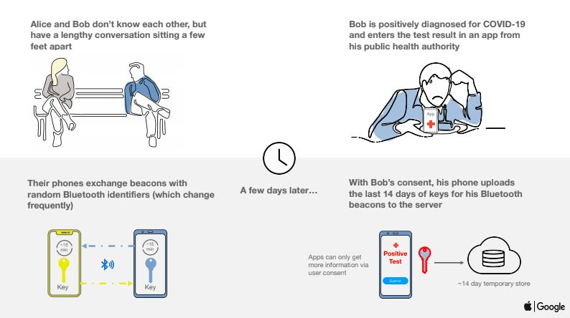
Exposure Notification System (Google/Apple)

